Slide 1
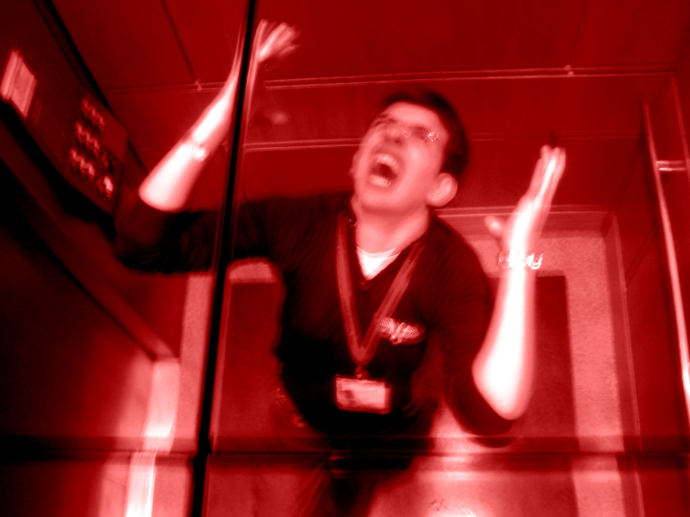
Elevator Pitch Workshop
Marketing yourself in the professional world

Slide 2
Contents
What is an elevator pitch?
What’s in a good pitch?
Examples
How to construct a pitch
Build your own
Critique others

Slide 3
What is an elevator pitch?
Purpose
Summarize aptitude and interest towards a particular job
Answers the question “Tell me about yourself”
Guidelines
Length: 30 to 60 seconds
Summarize 2 to 3 important “takeaways”

Slide 4
What’s in a good pitch?
Narrative
The story your experiences tell
What are the key experiences that define you?
How do they effect you?
Takeaways
What do you want me to remember from this interview?
What differentiates you?

Slide 5

Example 1: Billy Mays

Slide 6
Example 1: Kitchen
Strengths
Weaknesses
Very well spoken and enthusiastic
Has a clear objective and focus that builds a clear perspective
Summarizes takeaways
Over the top?
Credibility?
“Infomercial”
I can’t see myself working with this guy…

Slide 7
Example 2: the Engineer

Slide 8
Example 2: the Engineer
Strengths
Weaknesses
Clearly spoken
Outlines intention, future goals
Outlines why he thinks he is a “good fit.”
Way to long about background
Is it necessary to say 4th year and grad date?
Too detailed about future
What certification is he talking about and why is he getting it?
Differentiation
“Flexible and can learn”… so??
No specific past experiences

Slide 9
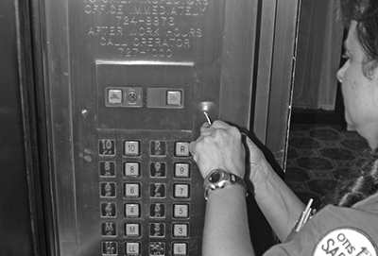
How to Build an Elevator

Slide 10
How to build an Elevator Pitch
1
List experiences in any order
Try to connect experiences to build key themes
2
Decide on 2-3 key themes
Eliminate all other experiences
3
Draft a few paragraphs
Narrow down to appx. one paragraph
4
Time and condense until ~45s.
Add about 10s of intro: Greeting, Name, Major

Slide 11

Other Tools
Framing experience
Situation/Task
Action
Result
Strong Action Verbs
Developed
Analyzed
Communicated
Planned

Slide 12
Getting You Started: My Experiences
High School
Wrestling Team Captain
Camp Councilor
YMCA Volunteer
Student Council
Freshman Year
Rugby Team
ChemE 112
Spanish Classes
Sales Job
Sophomore Year
Risk Manager
SEBA treasurer
P&G intern
Junior Year
Cornell Consulting Group
House Manager
Process Control

Slide 13
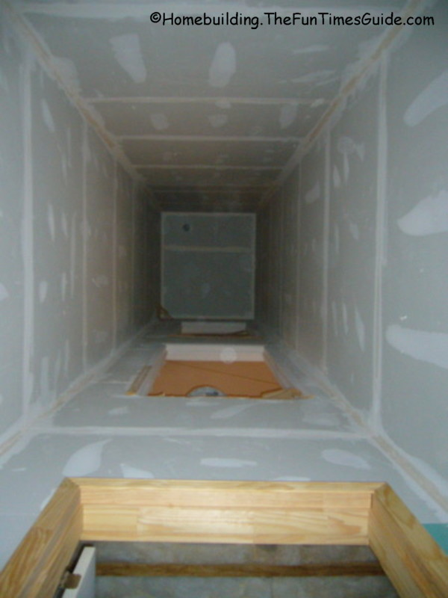
My Key Themes
Teamwork/Leadership
Wrestling Team Captain
ChemE 112
Cornell Consulting Group
House Manager
Technical Experience
Internship
Process Control

Slide 14
Do it Yourself:
1
List experiences in any order
Try to connect experiences to build key themes
2
Decide on 2-3 key themes
Eliminate all other experiences
3
Draft a few paragraphs
Narrow down to appx. one paragraph
4
Time and condense until ~45s.
Add about 10s of intro: Greeting, Name, Major

